Slide 1

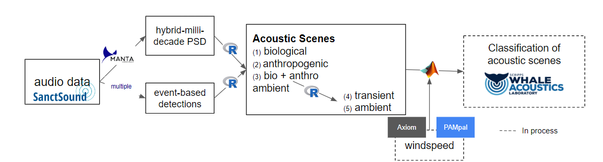

Underwater Soundscape Data
Leverage existing data products from 8 Sanctuary Soundscape Monitoring Project listening stations with event-based detection products | 1,057 days of data
NCEI cloud-hosted archive

Slide 2
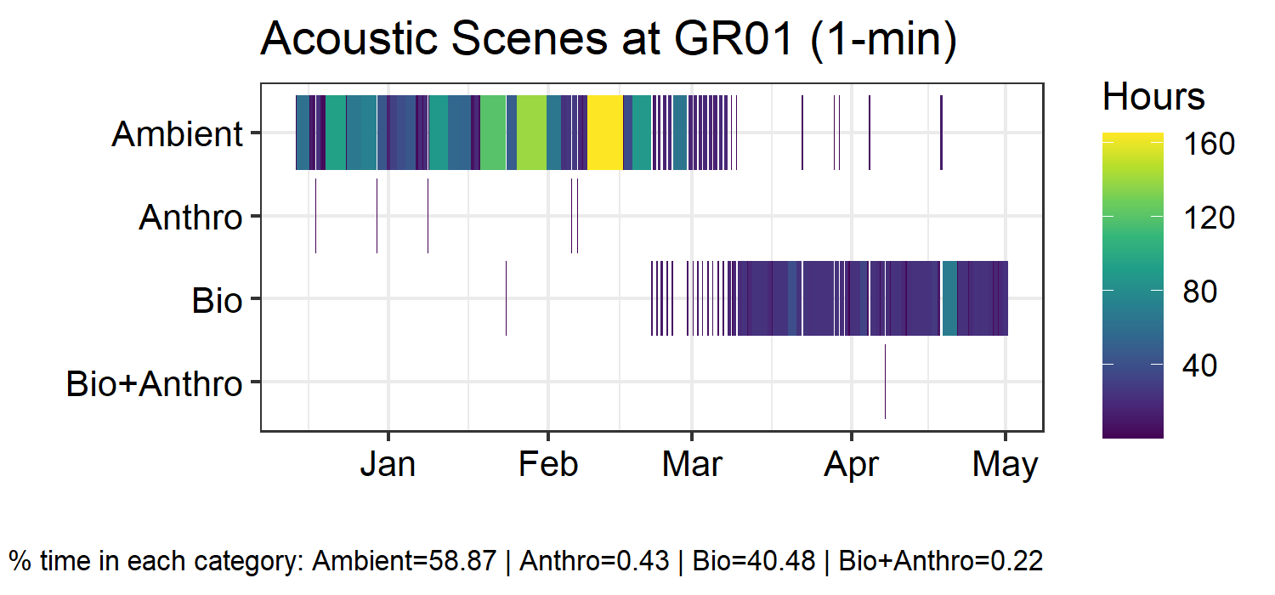
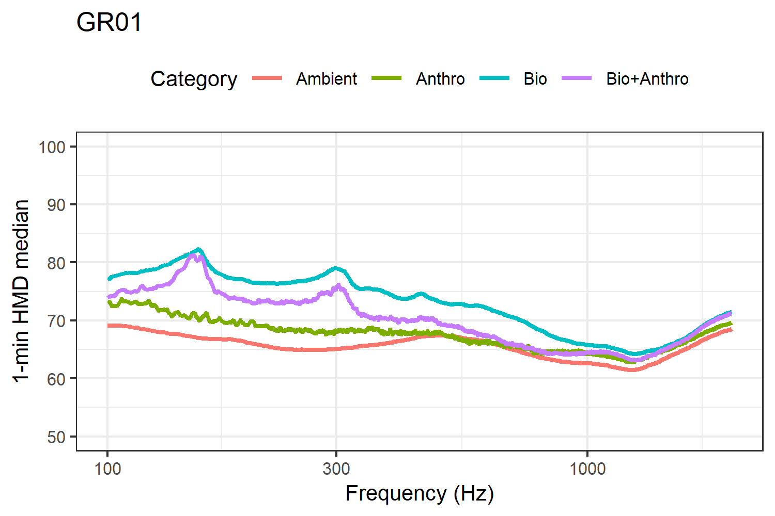
Gray’s Reef National Marine Sanctuary
Temporal pattern in acoustic scenes
Color = duration of scene
Spectral pattern in acoustic scenes
Color = type

Slide 3
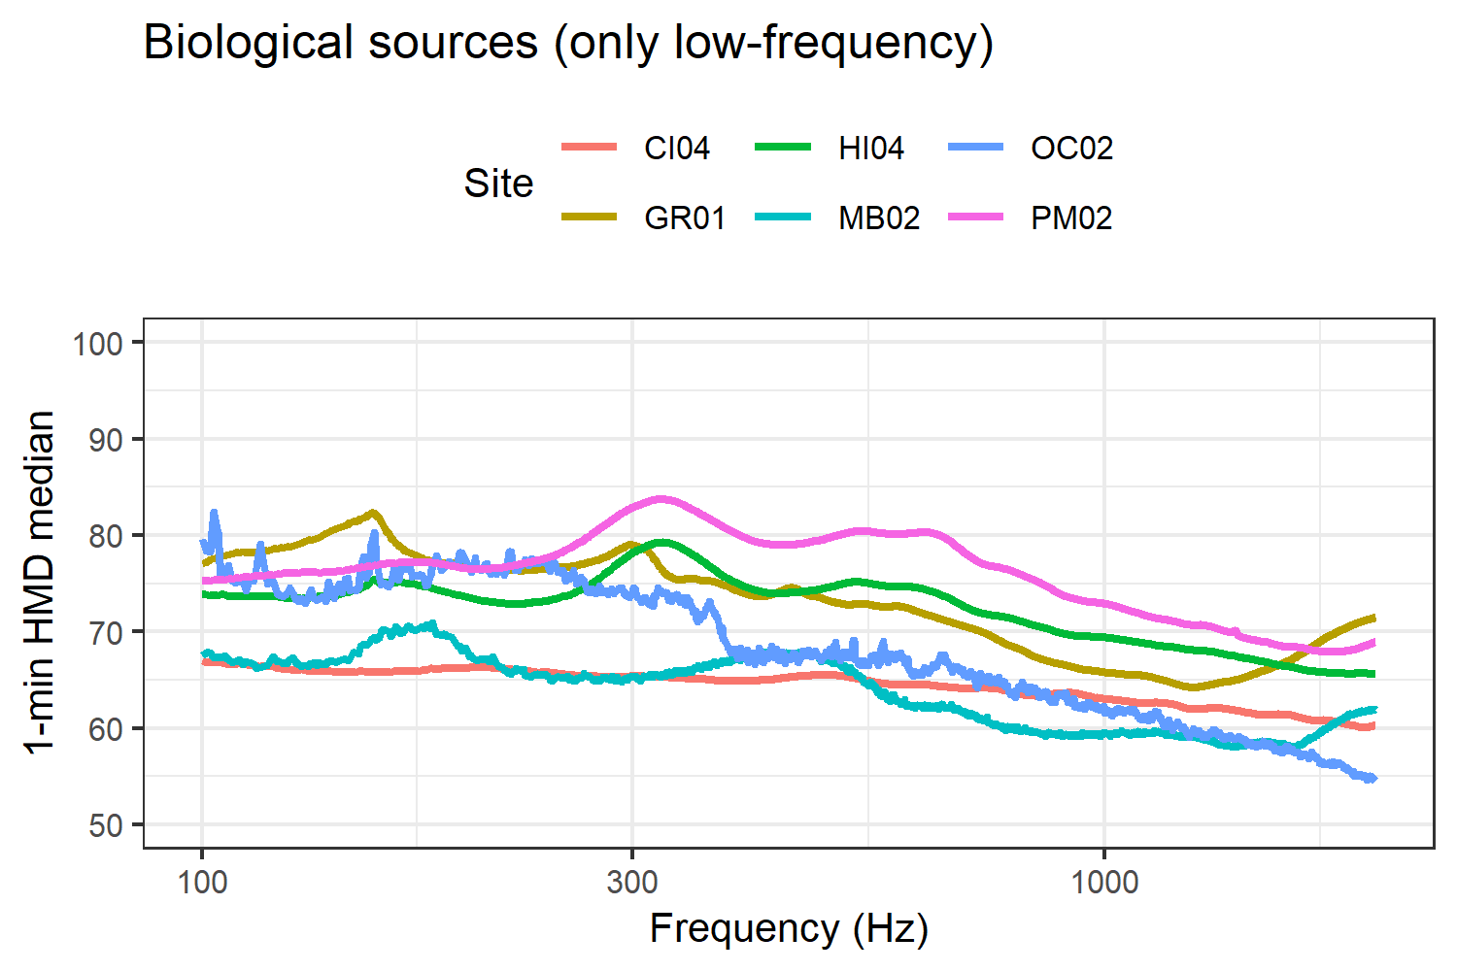
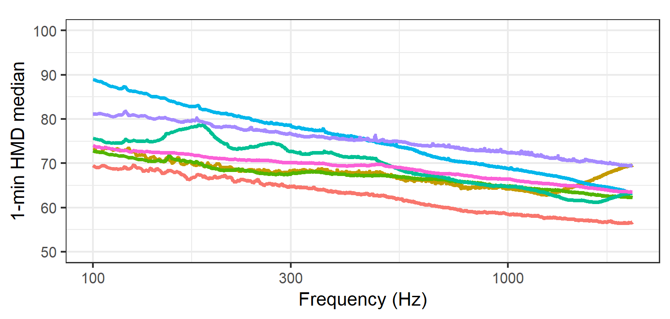
Spectral Patterns of Acoustic Scenes Across All Sites
Biological acoustic scene
Color = sites
Anthropogenic acoustic scene
Color = sites

Slide 4
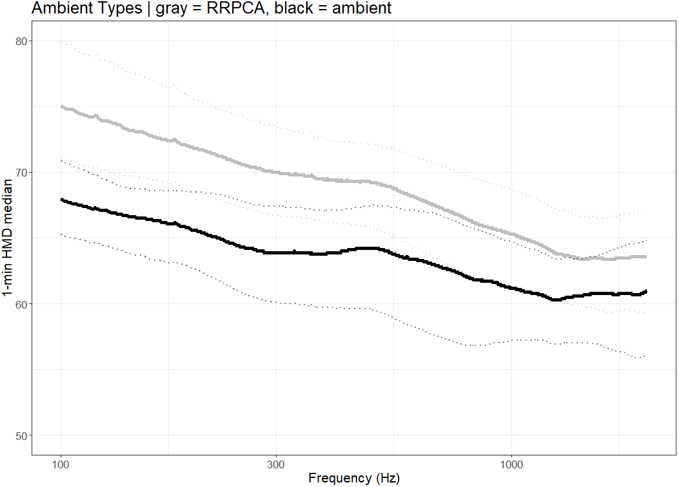
Spectral patterns of Acoustic Scenes RRPCA “detections”
“Undetected” signal present
Separated “ambient” acoustic scenes
All sites
“True” ambient sound samples

Slide 5
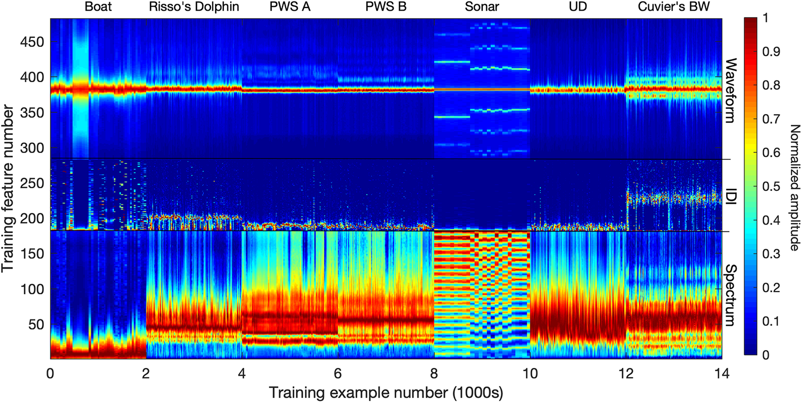
Classification of Acoustic Scenes Neural Net training
A machine learning pipeline for classification of cetacean echolocation clicks in large underwater acoustic datasets
Frasier | 2021 | PLOS

